Slide 1


SMART INDIA HACKATHON 2025
TITLE PAGE
Problem Statement ID – 25135
Problem Statement Title - Student Innovation: Swadeshi for Atmanirbhar Bharat - Smart Automation
Theme- Smart Automation
PS Category- Software
Team ID-
Team Name (Registered on portal)- HackEdemics

Slide 2

Resume Optimizer – AI-powered Resume Tailoring for Job Seekers
Points to include:-
Problem: Resumes get rejected due to poor keyword/job fit.
Solution: Upload resume + job description → tool analyzes & optimizes → output report with missing skills, score, and suggestions.
Uniqueness: Free, simple, Indian-user focused, instant feedback.
Value: Increases shortlisting chances, saves recruiter screening time.

Slide 3
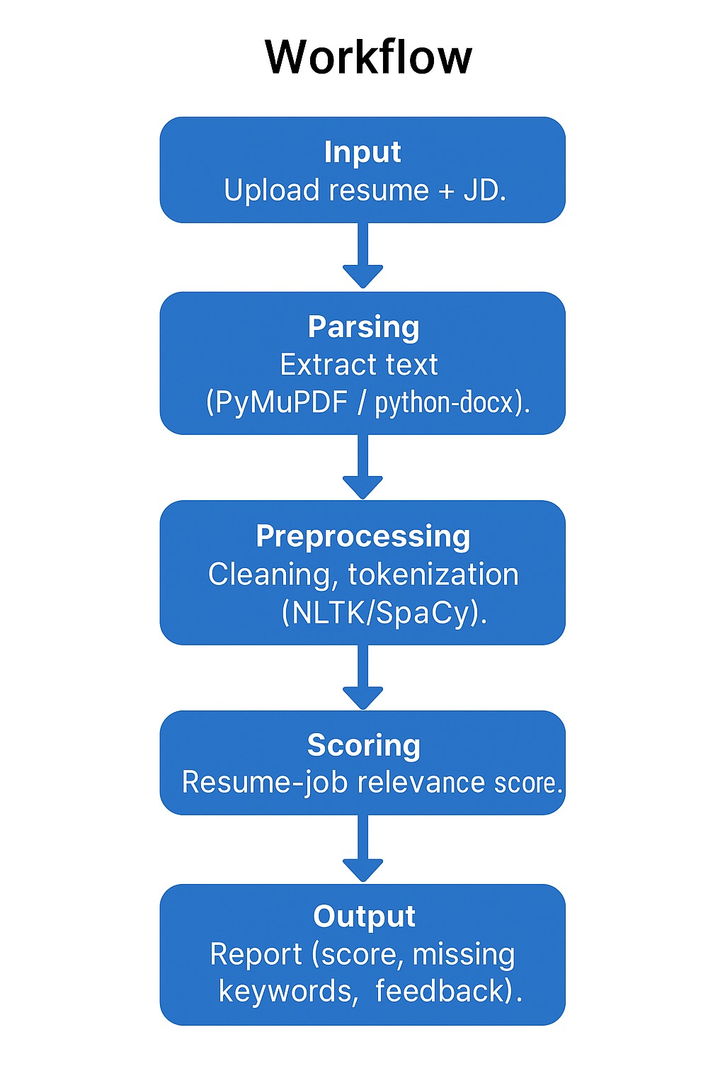
TECHNICAL APPROACH
Your Team Name
Workflow
Input – Upload resume + JD.
Parsing – Extract text (PyMuPDF / python-docx).
Preprocessing – Cleaning, tokenization (NLTK/SpaCy).
AI Analysis – Keyword extraction, semantic matching (TensorFlow/PyTorch).
Scoring – Resume-job relevance score.
Output – Report (score, missing keywords, feedback).
Tech Stacks
Frontend: React.js + Tailwind
Backend: Python (Flask/Django)
AI/NLP: NLTK, SpaCy, TensorFlow
Database: MongoDB
Deployment: Docker + Cloud (AWS/GCP)

Slide 4
FEASIBILITY AND VIABILITY
Your Team Name
FEASIBILTY:-
Technically feasible (AI + NLP widely used).
Scalable via cloud + containerization
CHALLENGES:-
Parsing inconsistent resume formats.
Semantic context understanding.
SOLUTIONS:-
Regex + NLP hybrid for parsing.
Iterative ML model training for better context.

Slide 5
IMPACT AND BENEFITS
Your Team Name
Impact:
Candidates: Higher chance of shortlisting, confidence boost.
Recruiters: Saves time, better resume quality.
Benefits:
Social: Democratizes access to better job opportunities.
Economic: Reduces unemployment caused by resume filtering.
Scalability: Can expand to multiple languages and regions.

Slide 6
RESEARCH AND REFERENCES
Your Team Name
https://www.careerflow.ai/resumeoptimizer#:~:text=What%20does%20the%20Resume%20Optimizer,to%20improve%20relevance%20and%20visibility. (IDEA)
https://www.youtube.com/watch?v=R5WXaxmb6m4&pp=0gcJCfwAo7VqN5tD (Workflow)
https://medium.com/illumination/the-great-indian-ai-gold-rush-how-salaries-skyrocketed-by-up-to-116-in-a-new-world-of-risk-and-c9d7d307622b#:~:text=A%20Senior%20AI%20Specialist%20who,L%20to%20%E2%82%B948.0L.&text=A%20visual%20comparison%20of%20annual,)%20to%202024%20(yellow). (RESEARCH)
Tools/libraries referenced: SpaCy, NLTK, PyMuPDF.

